Slide 1

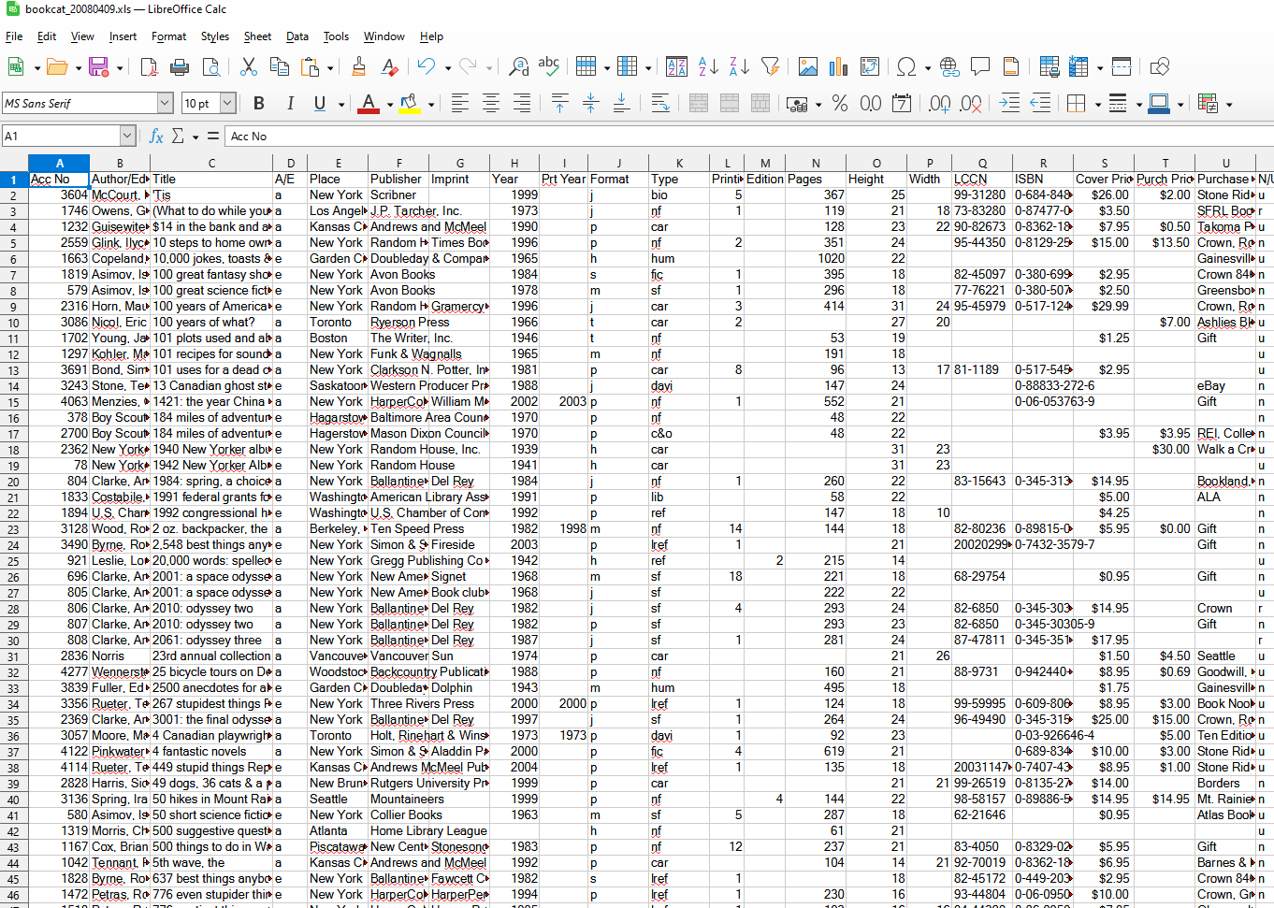



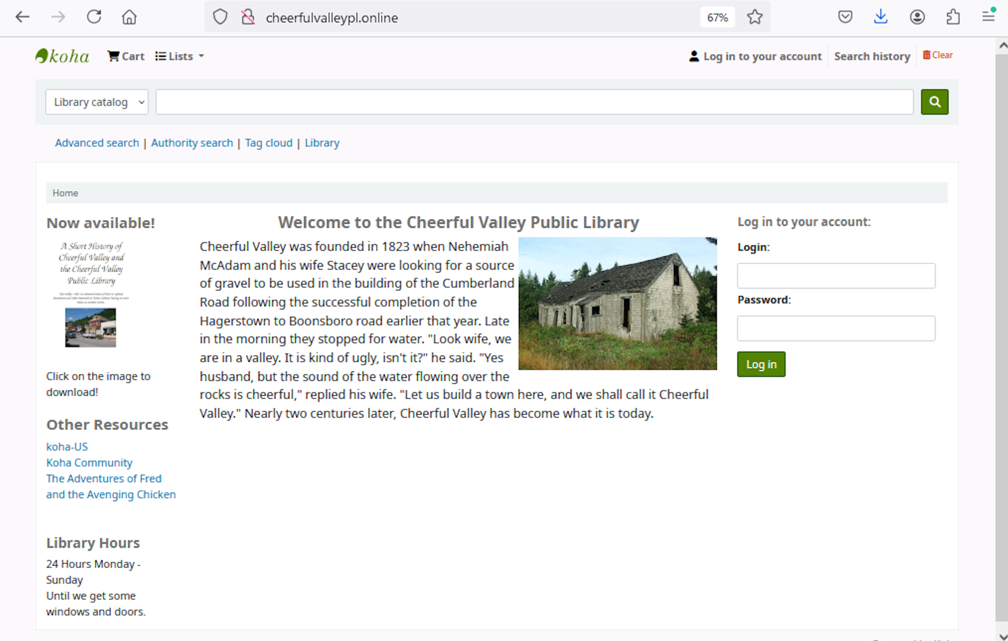



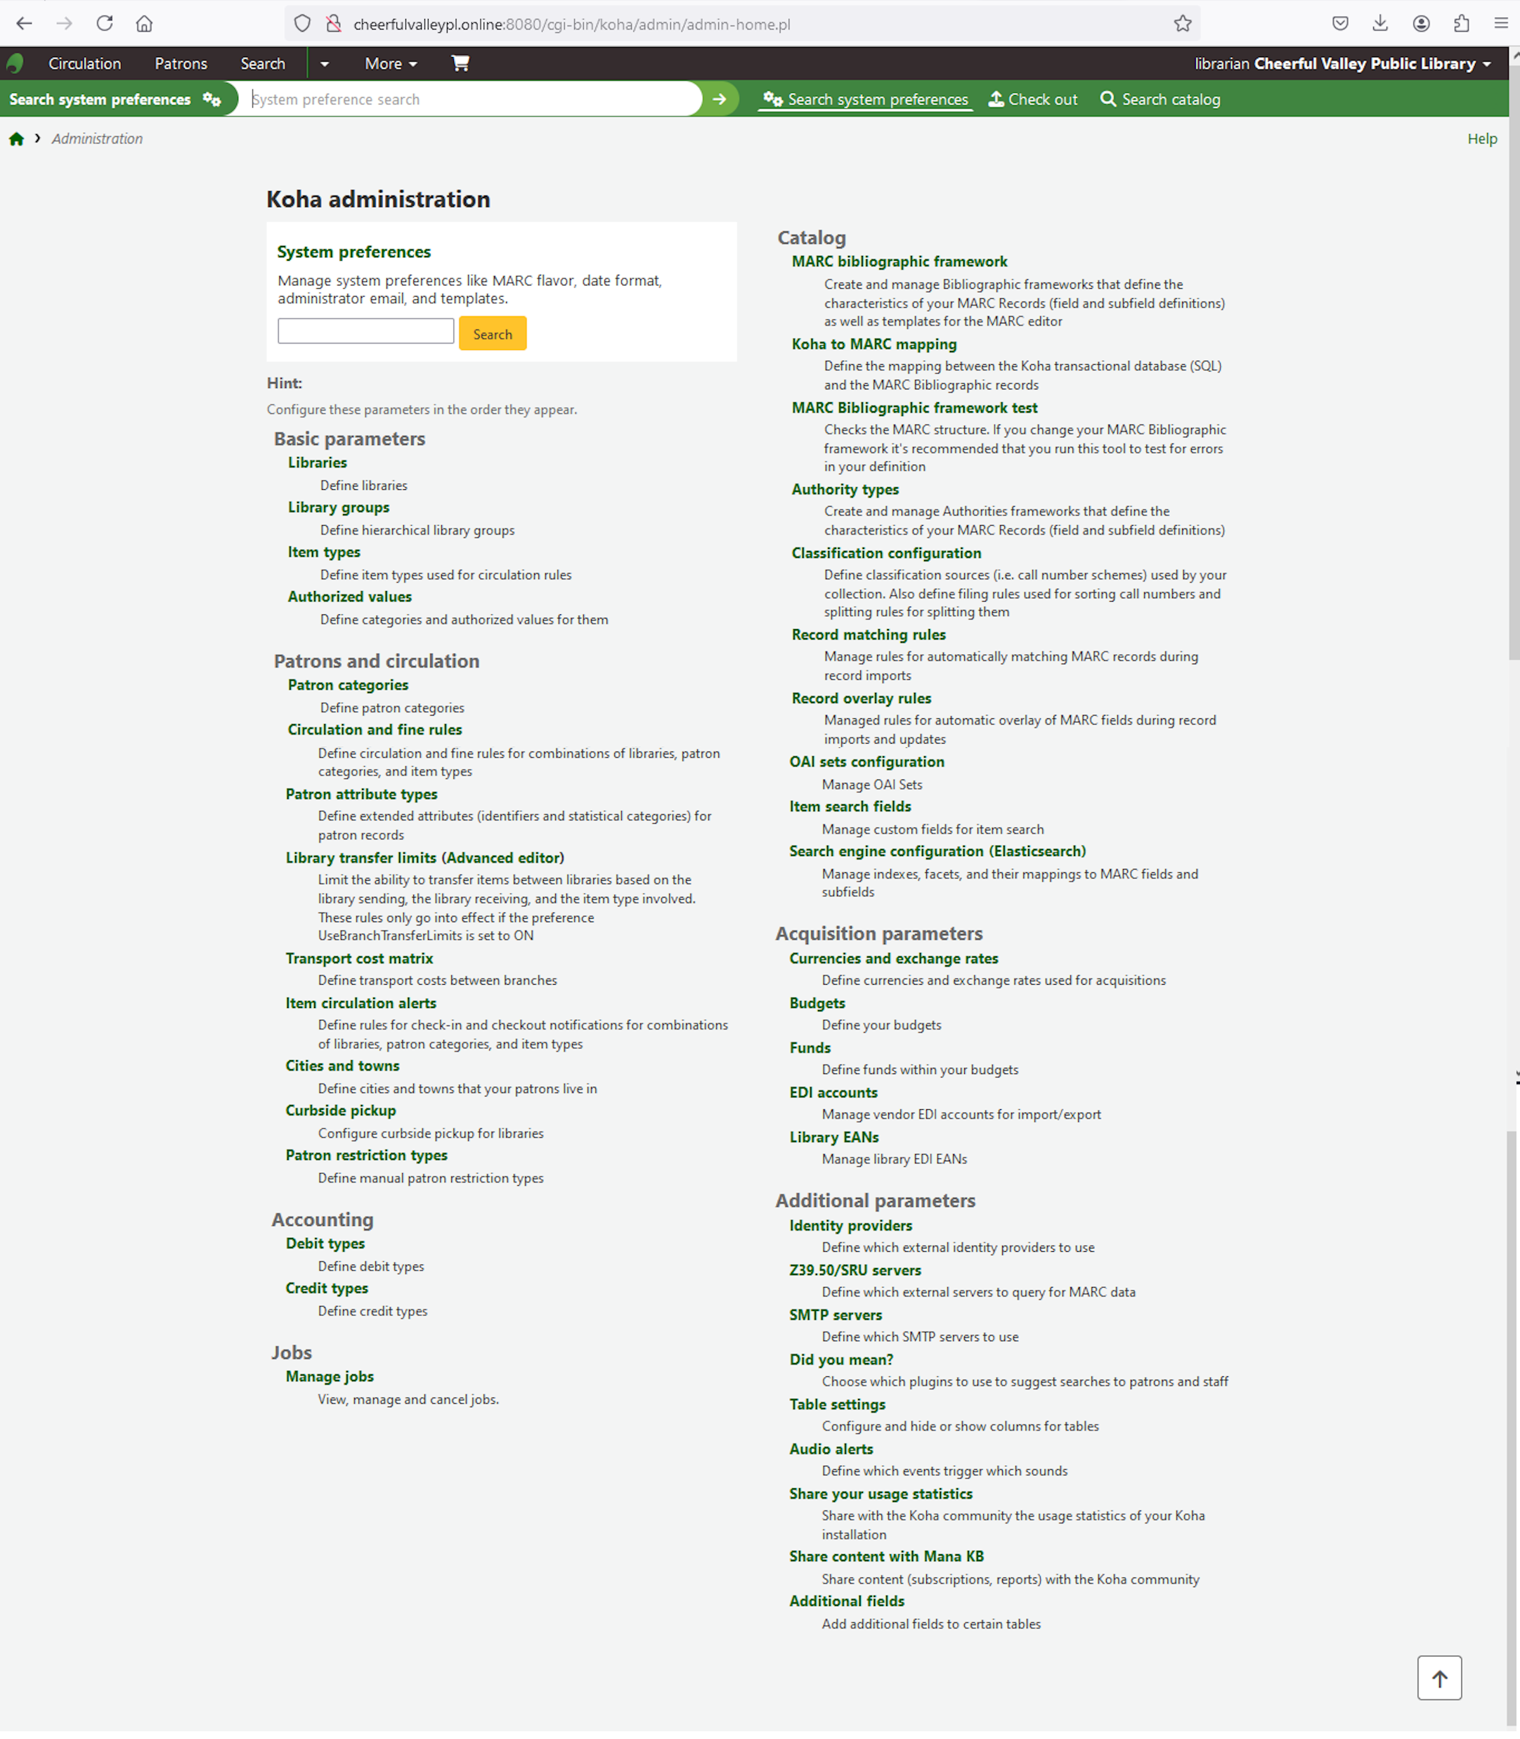


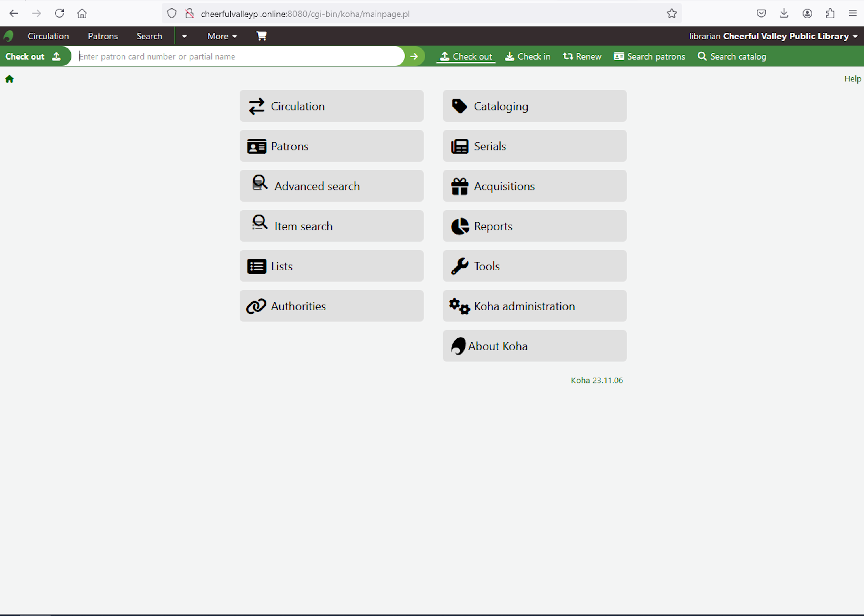
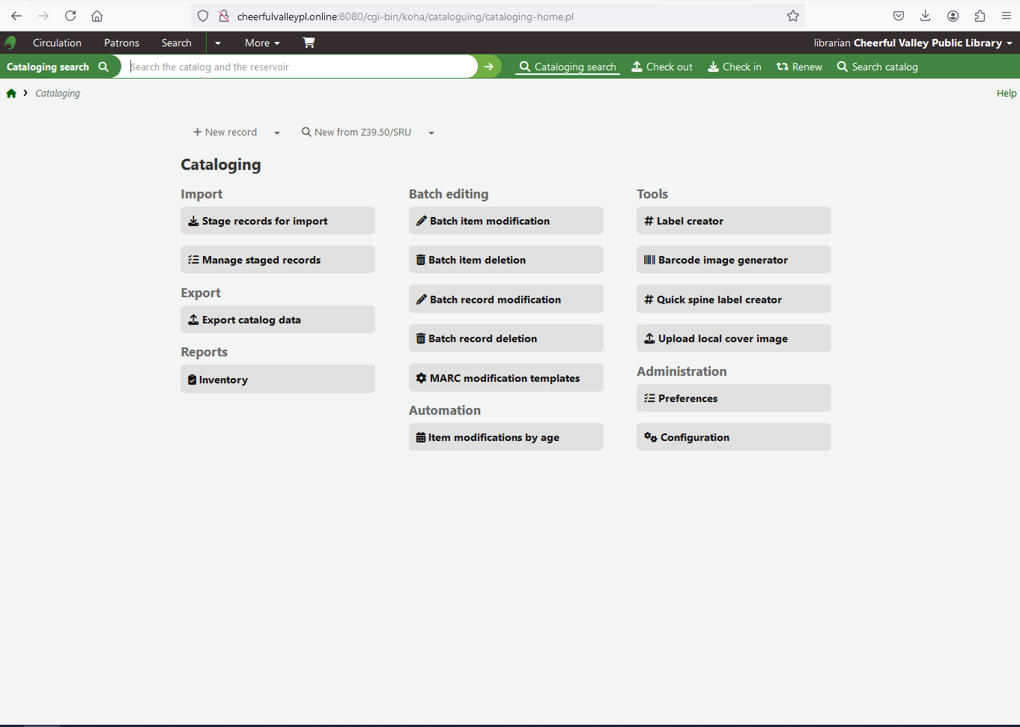
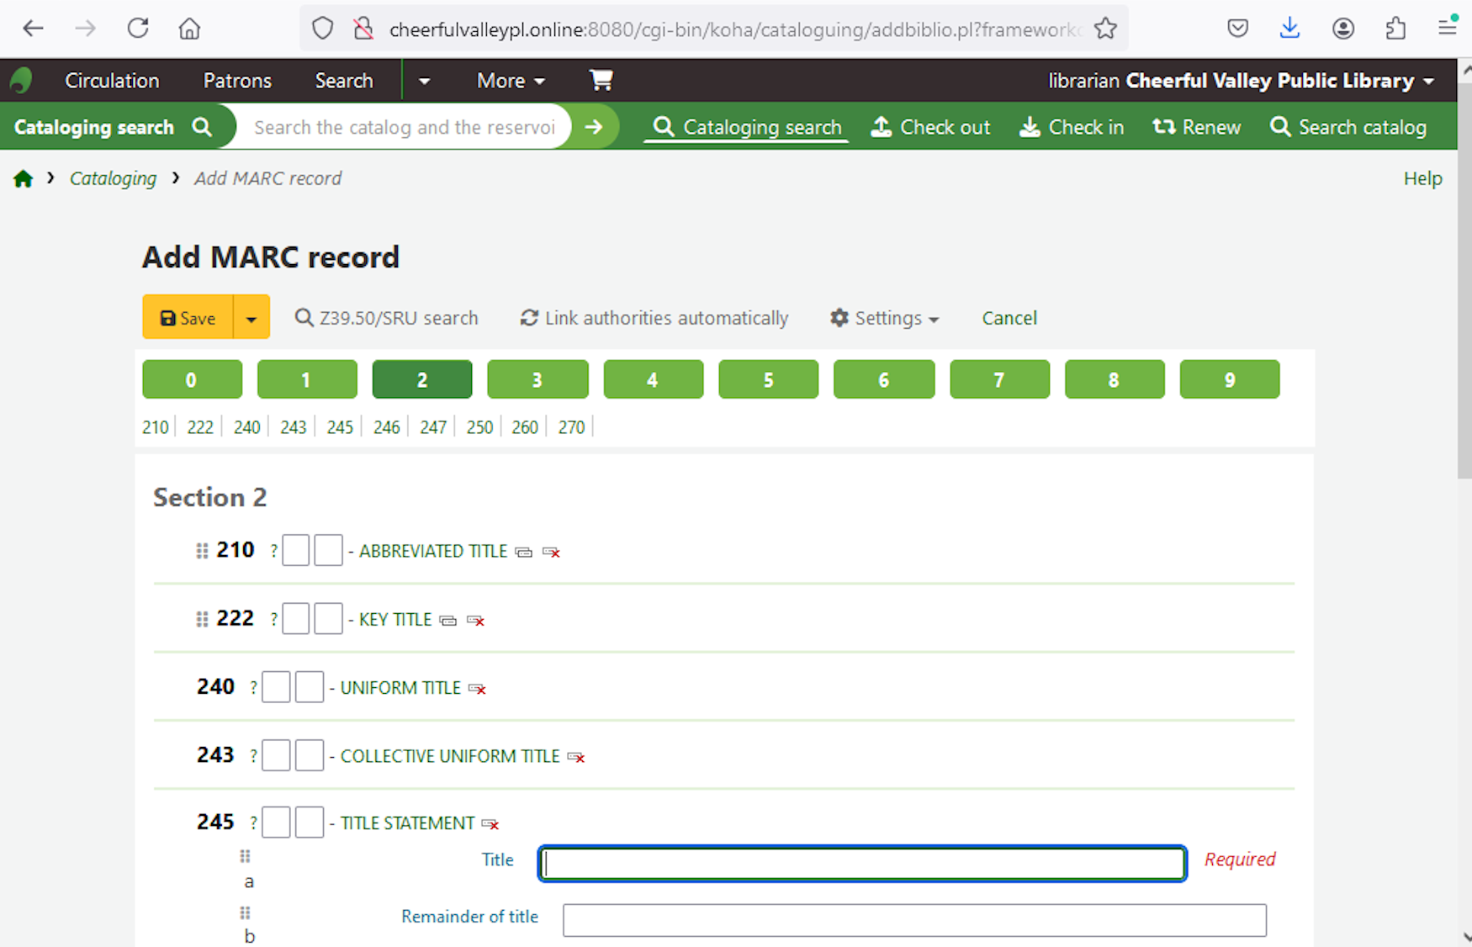
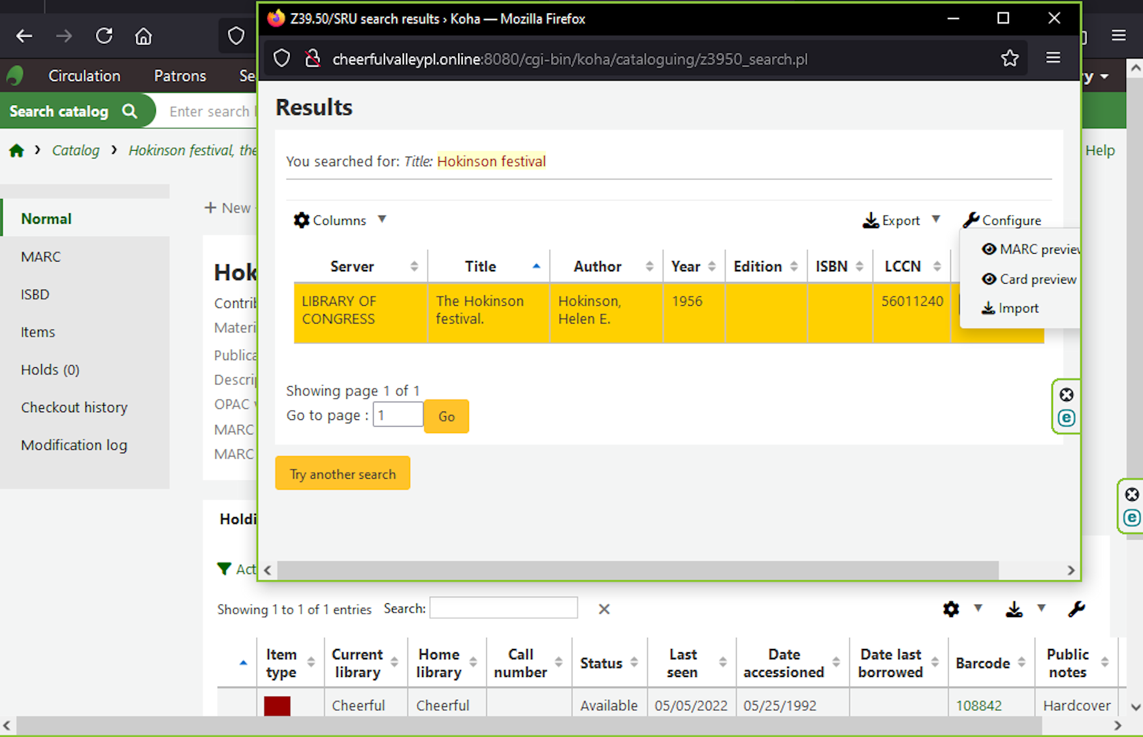
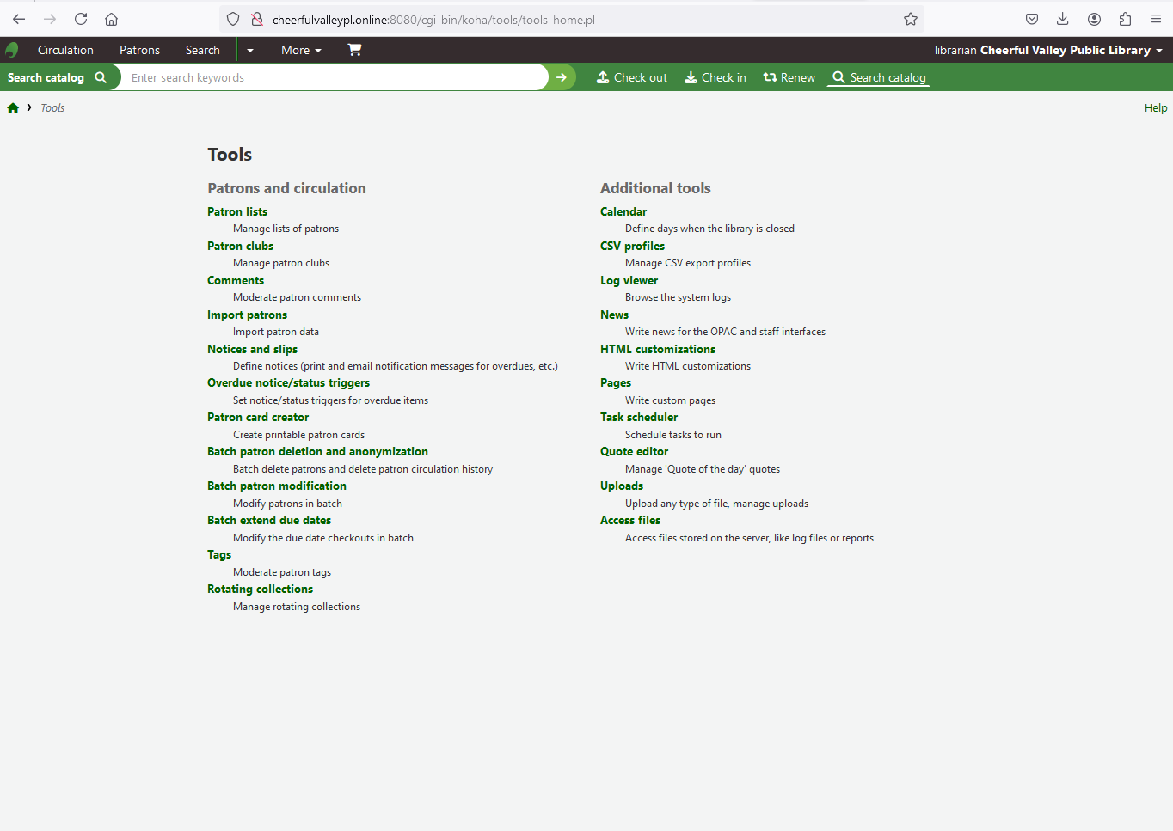
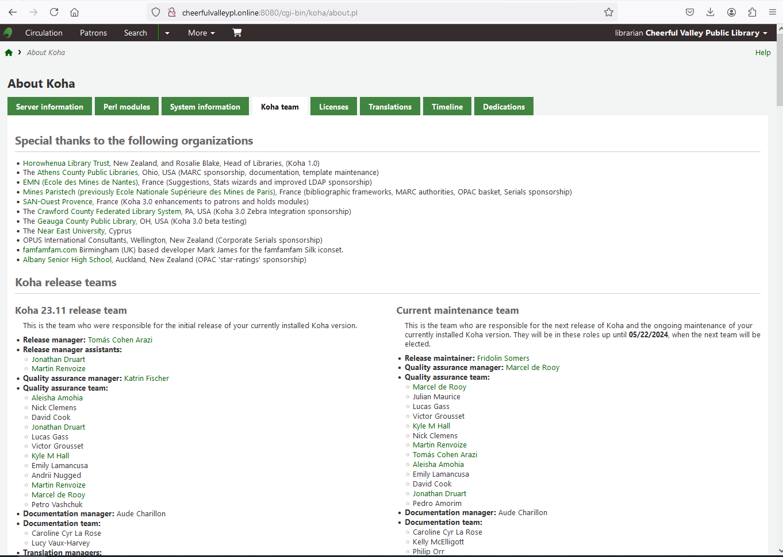
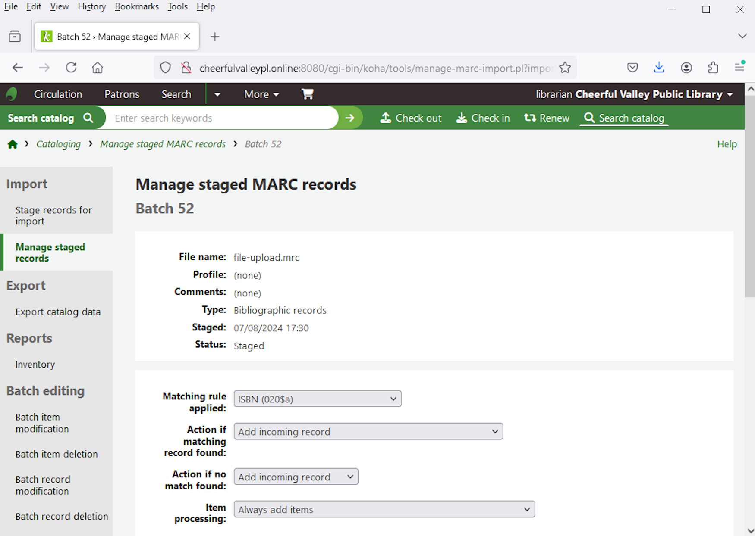
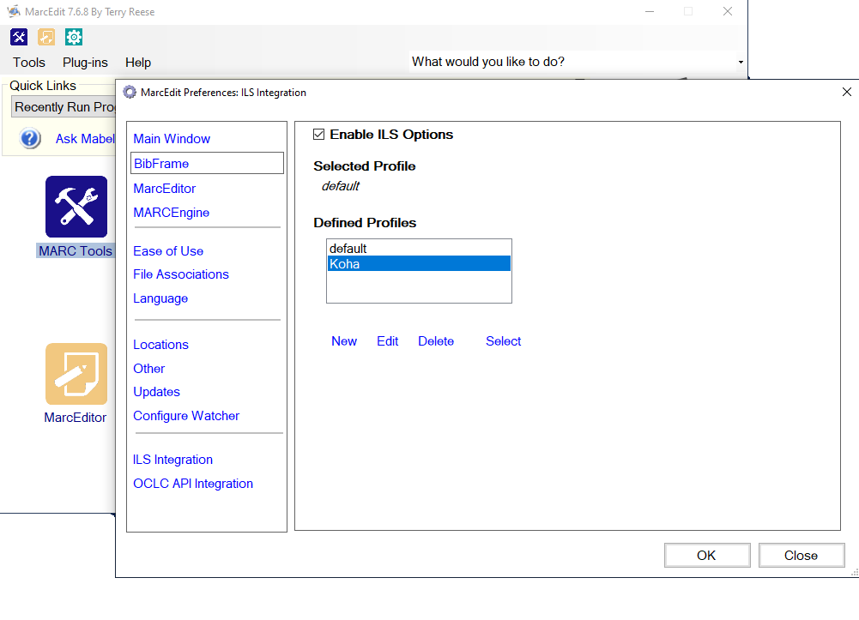

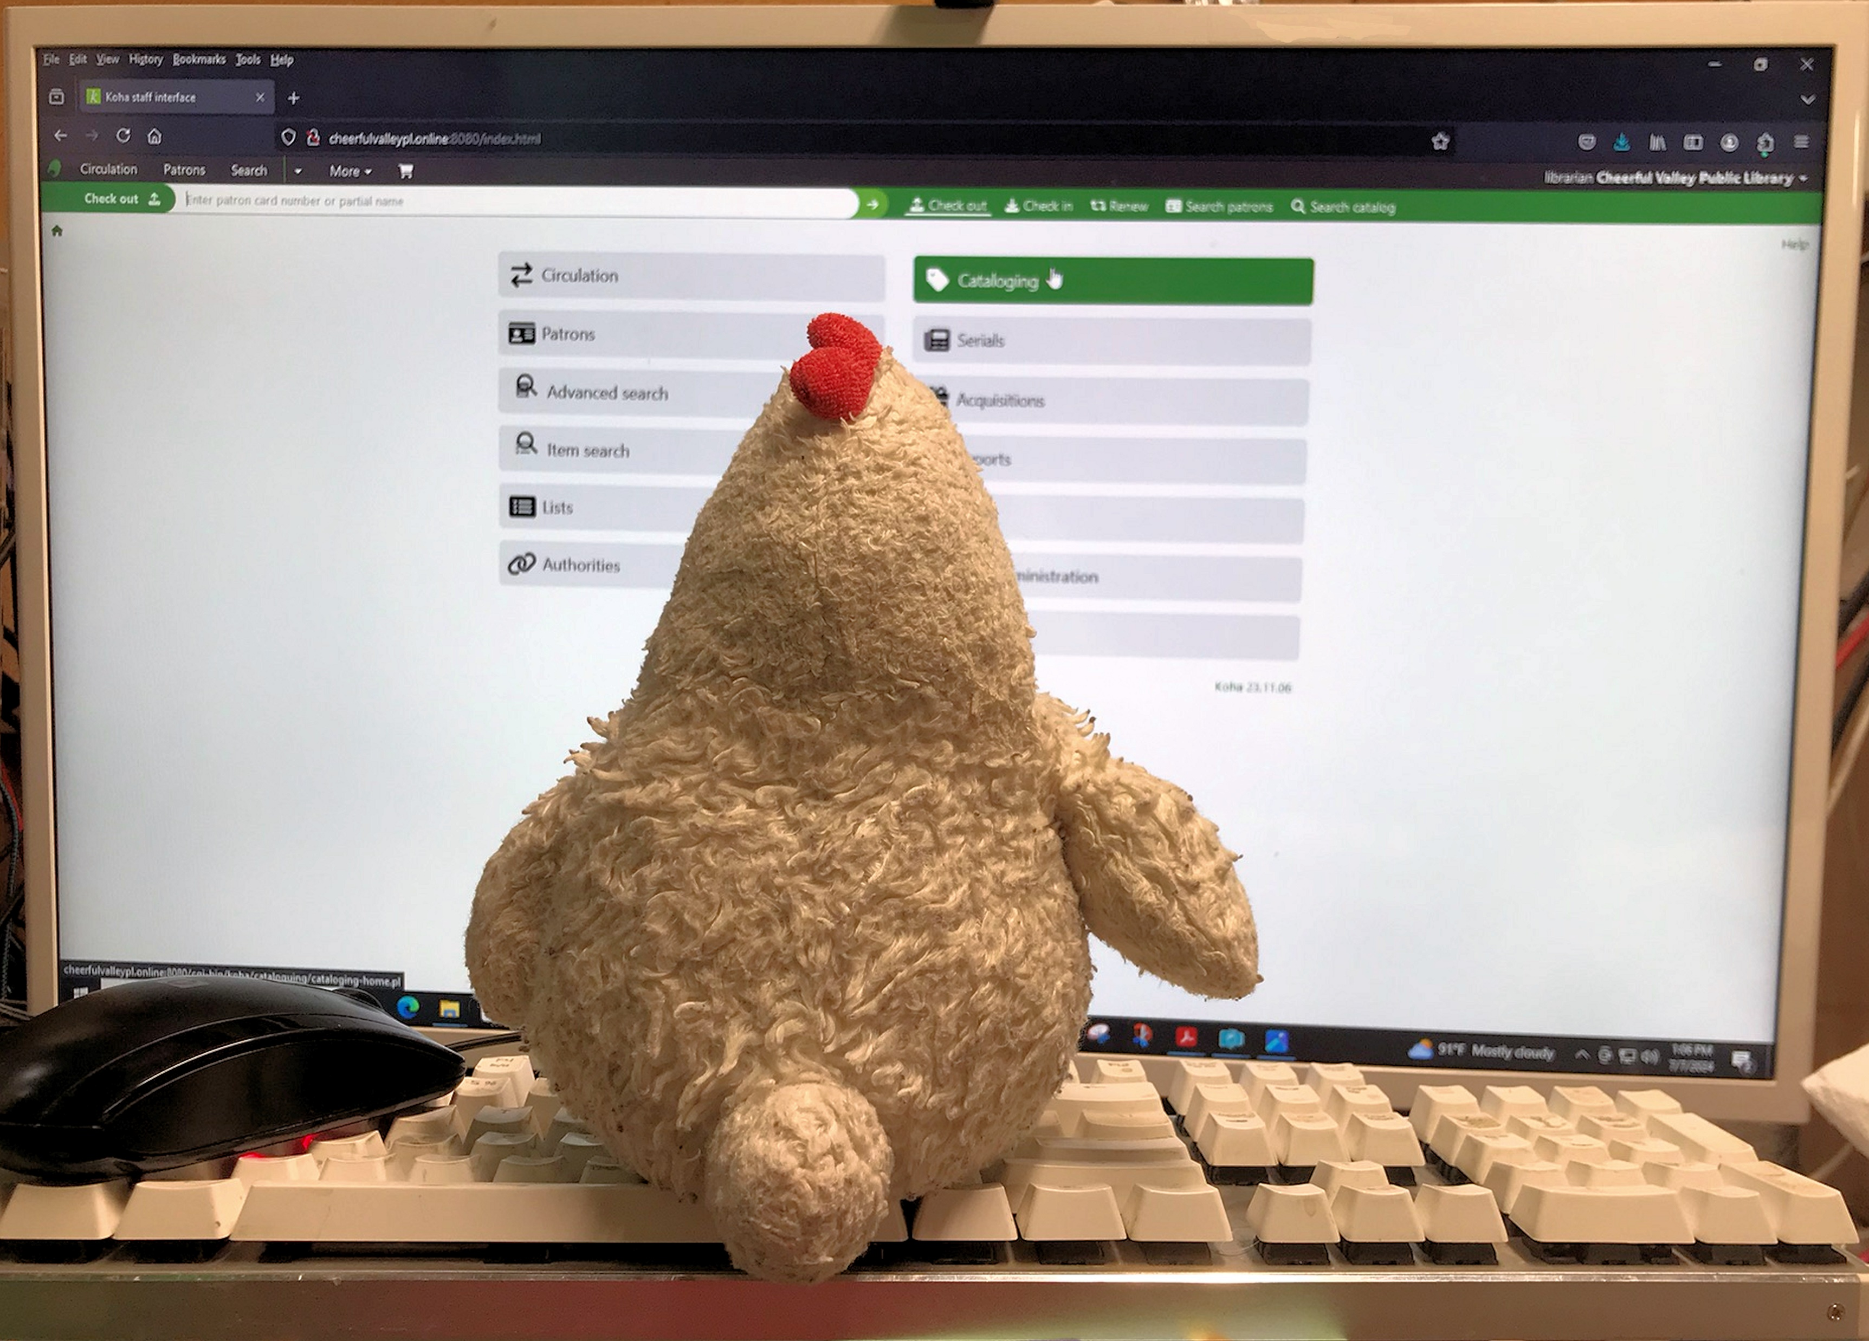
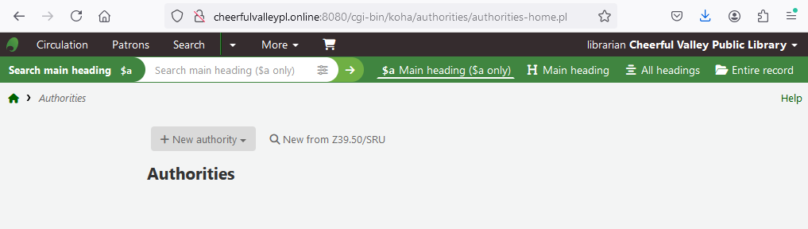

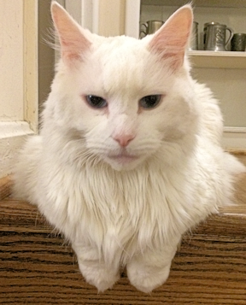

Introducing
Koha
The Best Integrated Library System Ever!
Is your library catalog on a spreadsheet?
Have you accidentally purchased multiple copies? That gets expensive!
Do you “know where things are?”
Can anybody else find them?
Maybe you need an ILS!
Want a look at a barebones work in progress? See http://cheerfulvalleypl.online
(not always available)
Why Koha?
It’s free!*
It’s fully functional—comes with all the modules you need. Use one or use them all
You can go from a Linux command line to a functioning library in an afternoon**
Koha is used by at least 4000 libraries big and small, all over the world. Maybe 15,000—nobody really knows.
Koha folks are friendly and helpful. Have a question? You can usually get an answer in a few hours.
It’s Open Source
No license fee needed—just download and install
It’s secure—maintained by thousands of developers around the world; bugs are quickly found and patched
Improvements are available to everyone. Want to make changes? Download the source code and experiment.
If one organization sponsors a feature, everybody gets to use it!
What do you need?
A server, 4GB RAM, 50GB hard drive for a small library
You can run it on a cloud server for around $30 USD per month
Or you can use a spare laptop, desktop--even a Raspberry Pi!
You need to be comfortable working with computers, including the command line
A very basic knowledge of Linux is helpful, but you’ll pick it up
The library at the Keys Catalog of Library & Archival Materials at San Francisco Maritime National Historical Park is more advanced. https://keys.bywatersolutions.com/
Koha sounds interesting. How can I
learn more?
Koha-Community has installation files, documentation, the Koha wiki, and much more. https://koha-community.org
koha-US is the users’ group for the United States, though everybody is welcome! Go to koha-US for training materials on modules, the Terrific Every-Other-Thursday Training Video series, meetings of the Special Interest Groups and the koha-US general meeting. https://koha-us.org
This is getting compli-cated. Can I get a vendor to do it for me?
Absolutely! See koha-community.org for a list.
Configure your library the way you want
Cataloging: the heart of any ILS
This is what you’ll see when you log in to the staff interface
Start your cataloging adventures here
Create your own MARC record
Update or add a record with Z39.50
A box of useful tools is at your disposal
Koha is a world-wide project, and you can contribute!
And it integrates with MarcEdit!
Upload batches of MARC records
So easy, even the Avenging Chicken can use it!
Author: Fred King, Medical Librarian, MedStar Washington Hospital Center. fred.king@medstar.net
Sources: koha-community.org, koha-US.org, librarytechnology.org
* As in free kittens, not free beer.
** With practice. Lots of practice.
This work is licensed under CC BY 4.0
Question the authority file!
Koha is infinitely configurable!

